Slide 1
EfficientNet: Rethinking Model Scaling for Convolutional Neural Networks
Mingxing Tan, ICML, 2019
Saebom Lee

Slide 2
Abstract
Compound coefficient : To show that balancing network depth, width, and resolution can lead to better performance
EfficientNet
Use neural architecture search to design a new baseline network, and scale it up
Compound
coefficient
8.4x smaller and 6.1x faster
Neural architecture search: A method to find the optimal network based on reinforcement learning, Use to design optimal baseline Network.
Notes:
원래 기존의 CNN은 한정된 자원에서 개발되어왔으며, 자원이 추가적으로 지원되는 한도 내에서 더 높은 정확도를 위해 그 크기를 키워가는 방향으로 발전되어왔습니다.
이 논문에서는 model scaling의 성능 대해 명확히 밝히기 위해 연구하게 되며, network의 depth width resolution 사이의 관계에 대한 균형을 맞춰서 더 나은 성능을 보여주기위해,/ 새로운 scaling 방법인 compound coefficient를 제안합니다.
또한 model 성능에서는 baseline network가 중요하므로, 최적의 baseline network를 설계하기 위해 강화학습 기반의 최적의 network를 찾는 방법인 neural architecture search를 사용하여 baseline network를 설계합니다.
그리고 이 baseline network를 scale up하여 efficient net을 설계하고, 이는 최신 convnet보다 8.4배 더 작으며 6.1배 빠른 성능을 보여준다.

Slide 3
Contents
Sec1. Introduction
Sec2. Related Work
Sec3. Compound Model Scaling
Sec4. EfficientNet Architecture
Sec5. Experiments
Sec6. Discussion
Sec7. Conclusion

Slide 4
Sec1. Introduction

Slide 5
Introduction
Paragraph 01
In previous work, it is common to scale only one of the three dimensions – depth, width, and image size.
Though it is possible to scale two or three dimensions arbitrarily, arbitrary scaling requires tedious manual tuning and still often yields sub-optimal accuracy and efficiency.
Paragraph 02
“Is there a principled method to scale up ConvNets that can achieve better accuracy and efficiency?”
Our empirical study shows that it is critical to balance all dimensions of network width/depth/resolution, and surprisingly such balance can be achieved by simply scaling each of them with constant ratio.
=> Compound scaling method(not arbitrary scaling but uniformly scaling with a set of fixed scaling coefficients)

Slide 6
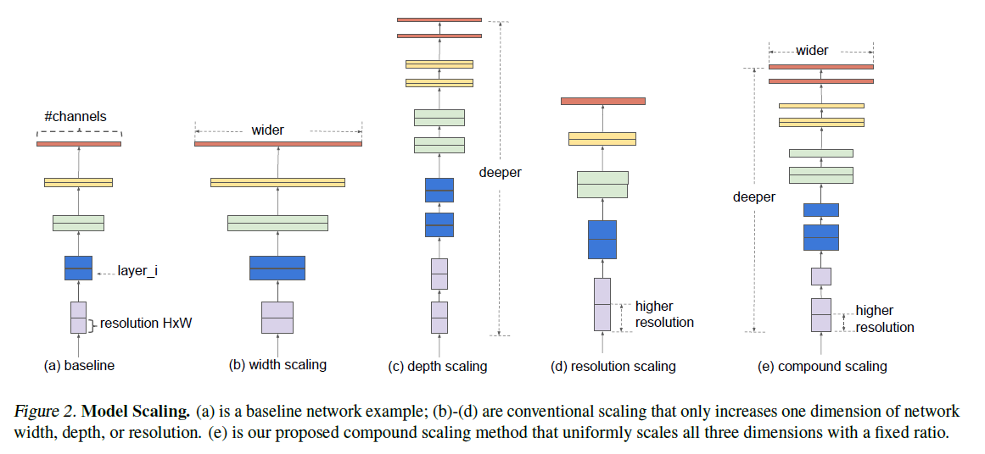
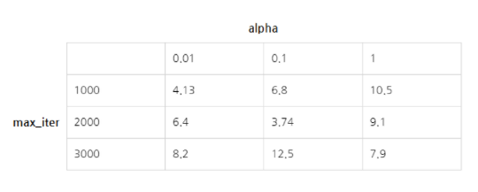
Introduction
Grid search
Notes:
Grid search는 표로 여러 하이퍼파라미터 값들을 나열한 후 가장 성능이 좋은 하이퍼파라미터 를 선택하여 사용
Width scaling 채널 수 키워주는 것
Depth scaling layer의 개수를 늘리는 것
Resolution scaling input resolution증가
Compound 이를 합친것

Slide 7
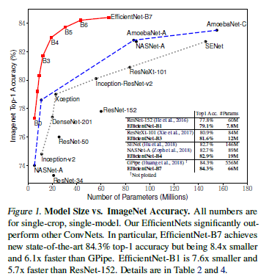
Introduction
Paragraph 03
Intuitively, the compound scaling method makes sense because if the input image is bigger, then the network needs more layers to increase the receptive field and more channels to capture more fine-grained patterns on the bigger image.
Paragraph 04
Notably, the effectiveness of model scaling heavily depends on the baseline network;
To go even further, we use neural architecture search to develop a new baseline network, and scale it up to obtain a family of models, called EfficientNets.

Slide 8
Sec3. Compound Model Scaling
Sec 3-1. Problem Formulation
Sec 3-2. Scaling Dimensions
Sec 3-3. Compound Scaling

Slide 9


Problem Formulation
ConvNet Composed layer
ConvNet Layer i
Yi = Fi(Xi)
Yi: output tensor
Xi: input tensor
Fi: operator
With tensor shape <Hi , Wi, Ci>
Hi, Wi -> spatial dimension
Ci -> channel dimension

Slide 10
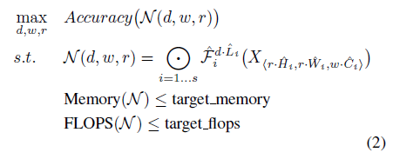

Problem Formulation
d, w, r : coefficients for scaling network depth, width, and resolution
Layer를 깊게
채널 수 변경
predefined parameters in baseline network
Input resolution
변경
*FlOPS: 컴퓨터 성능 지표, 초당 부동소수점 연산량

Slide 11
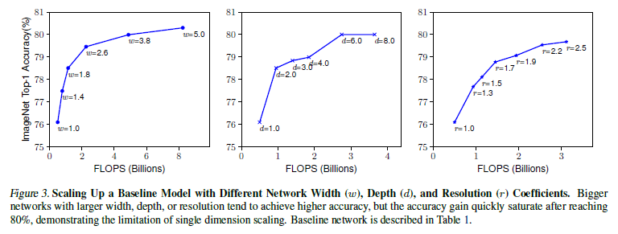
Scaling Dimensions
The optimal d, w, r depend on each other and the values change under different resource constraints. Due to this difficulty, conventional methods mostly scale ConvNets in one of these dimensions:
80% saturation -> The limitation of single dimension scaling
Notes:
D,w,r 은 연관되어있고, 서로 다른 resource 제약에 놓여있어서, 기존 방법들은 한가지만 scaling하는 방법 사용
but the accuracy gain quickly saturate after reaching 80%, demonstrating the limitation of single dimension scaling.

Slide 12
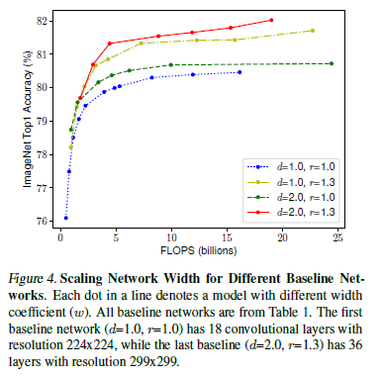
Compound Scaling
In order to pursue better accuracy and
efficiency, it is critical to balance all dimensions of network
width, depth, and resolution during ConvNet scaling.

Slide 13
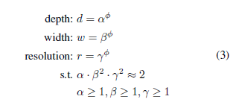




Compound Scaling
-> To uniformly scales network width, depth, and resolution
-> controls how many more resources are available
for model scaling
-> constants that can be determined by a small grid search
Notably, the FLOPS of a regular convolution op is proportional to d, w^2, r^2.
By eq3
Notes:
저자는 compound coefficient 파이를 사용하여 network의 width, depth, resolution을 균등하게 조정하는 compound scaling method를 제안한다.
파이는 얼마나 많은 resource를 사용할지에 대해 사용자가 정할 coefficien이며, 알파베타 감마는 small grid search 방법으로 찾게될 변수들.
특히 convolution operatio의 FLOPS는 d, w2, r2에 비례하여 증감하는 성질을 갖고있음.
Convnet의 flops는 convolution operation이 지배적. 따라서 비례한다고 볼수있음.

Slide 14
Sec4. EfficientNet Architecture

Slide 15
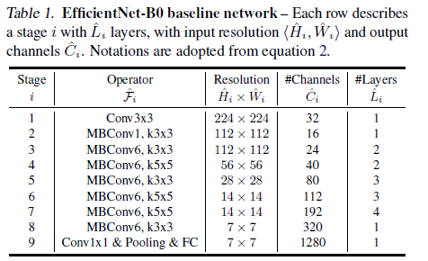
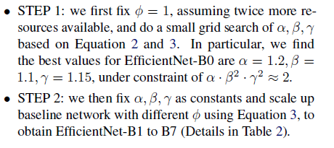
EfficientNet Architecture
Notes:
STEP.1
먼저 ϕ=1 로 고정한 뒤 grid search 를 수행하여 α,β,γ 값을 찾는다. (식 2,3을 이용)
EfficientNet-B0 에 대해 논문에서 찾은 값은 α=1.2,β=1.1,γ=1.15
이 값은 α⋅β2⋅γ2≃2 를 만족한다.
STEP.2
α,β,γ 값을 고정한 뒤 서로 다른 ϕ 값을 조절한다. (식3 참고)
이렇게 해서 얻어진 결과가 EfficientNet-B1 ~ B7 까지이다.
자세한 사항은 Table.2 를 참고하자.

Slide 16
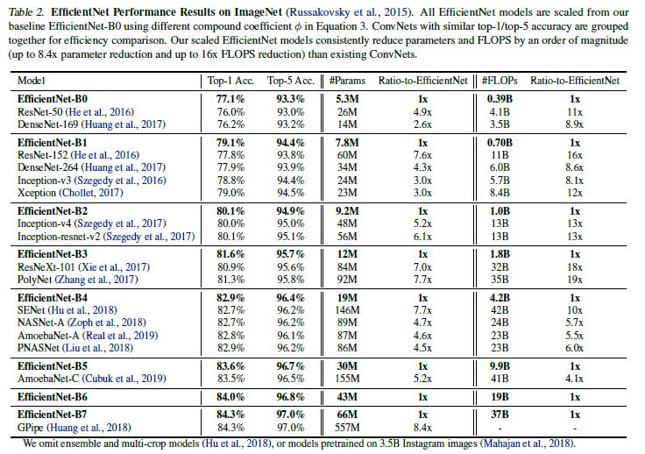
EfficientNet Architecture

Slide 17
Sec5. Experiments
Sec 5-1. Scaling Up MobileNets and ResNets
Sec 5-2. ImageNet Results for EfficientNet
Sec 5-3. Transfer Learning Results for EfficientNet

Slide 18
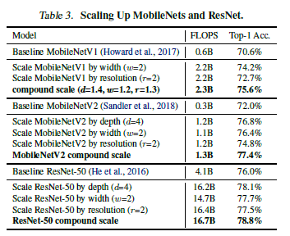
Scaling Up MobileNets and ResNets

Slide 19
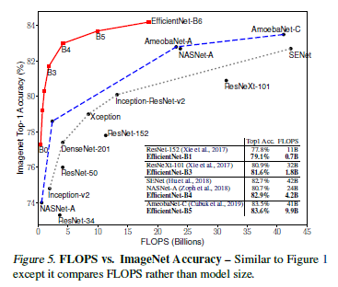
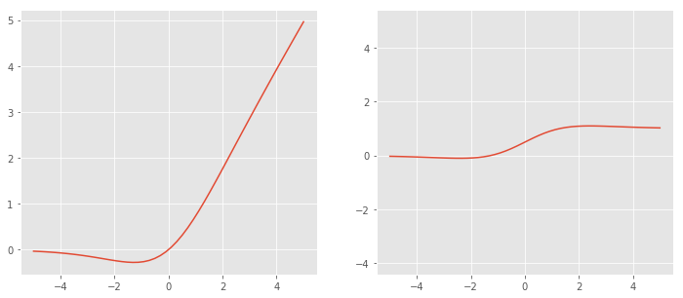
ImageNet Results for EfficientNet
RMSProp optimizer (decay: 0.9, momentum: 0.9)
batch-norm momentum: 0.99
weight decay: 1e-5
initial lr: 0.256 (decay: 0.97, every 2.4 epochs)
Swish activation 사용
stochastic depth with drop ratio:0.3
Bigger models need more regularization
(EfficientNet-B0: 0.2 dropout, EfficientNet-B7 : 0.5 dropout)

Slide 20
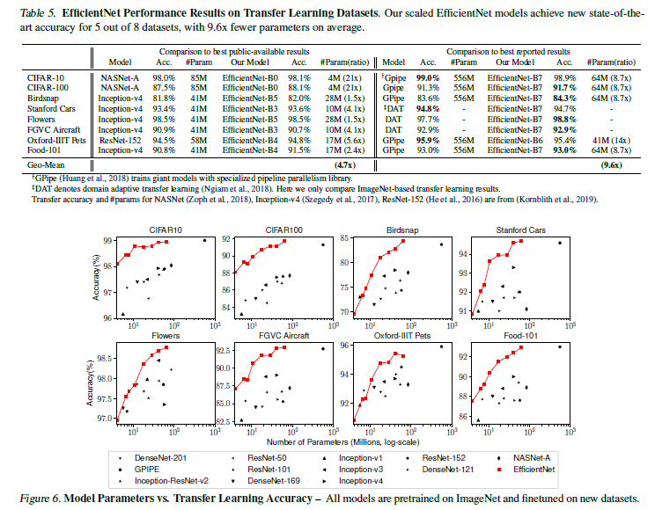
Transfer Learning Results for EfficientNet

Slide 21
Sec6. Discussion

Slide 22
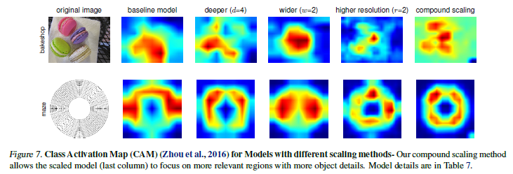
Discussion
Notes:
In order to further understand why our compound scaling method is better than other

Slide 23
Sec7. Conclusion

Slide 24
Conclusion
In this paper, we propose a simple and highly effective compound scaling method, which enables us to easily scale up a baseline ConvNet to any target resource constraints in a more principled way, while maintaining model efficiency.
Powered by this compound scaling method, we demonstrate that a mobilesize EfficientNet model can be scaled up very effectively, surpassing state-of-the-art accuracy with an order of magnitude fewer parameters and FLOPS, on both ImageNet and five commonly used transfer learning datasets.
Notes:
본 논문에서는 compoundscaling method을 제안하며 모델 효율성을 유지하면서, scale up을 수행한다.
훨씬 적은 매개 변수와 FLOPS로 sota 알고리즘의 정확도를 능가할 수 있음을 입증한다.

Slide 25
Source Code

Slide 26
Source Code
Framework : torch
Code location : https://github.com/tjems6498/Image_Classification/tree/master/EfficientNet.

Slide 27
Source Code
EfficientNet
CNNBlock
InvertedResidualBlock
CNNBlock
FC
X 7
1x1
Conv2d
CNNBlock
SqueezeExcitation
Conv2d
BatchNorm2d
AdaptiveAvgPool2d(1)
Global average Pooling
Conv2d
SiLU(=Swish)
SiLU
Conv2d
Sigmoid

Slide 28
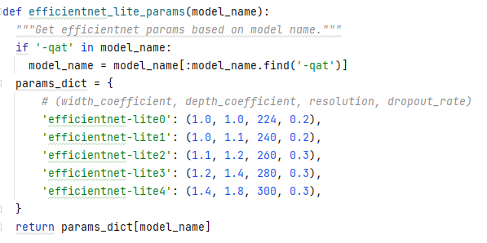
Source Code

Slide 29
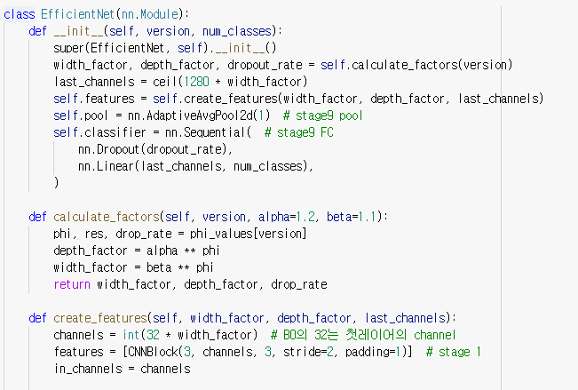
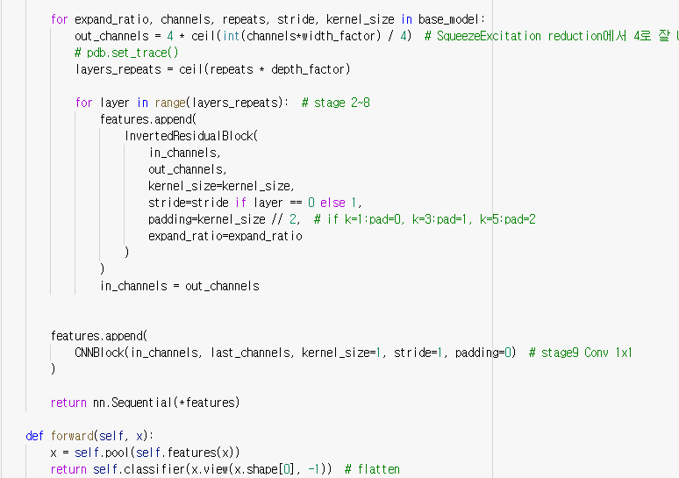
Source Code

Slide 30
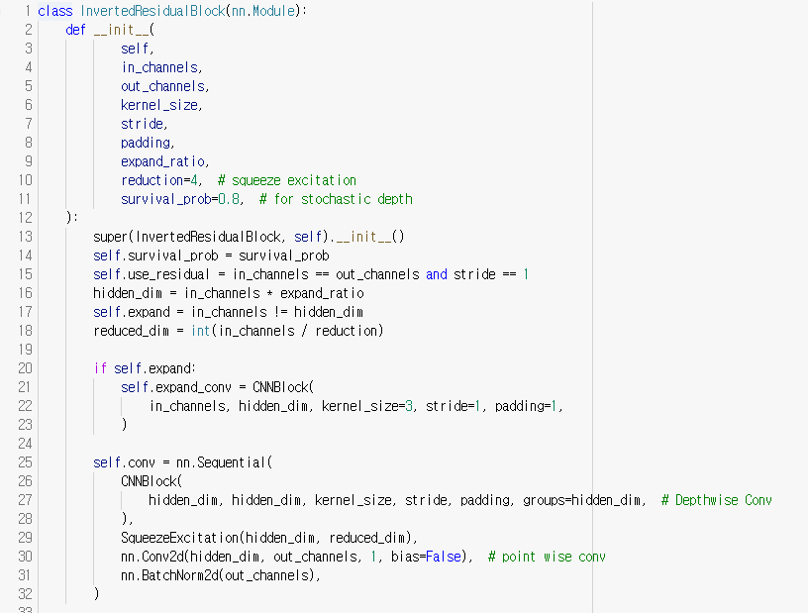
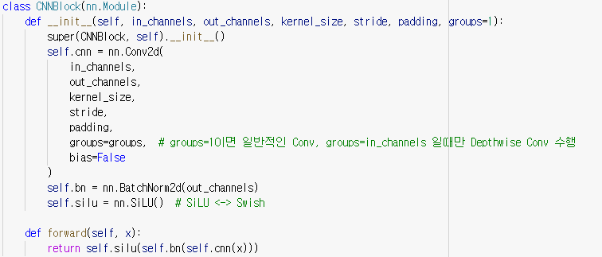
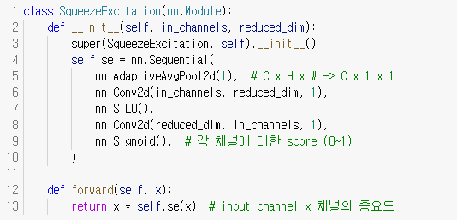
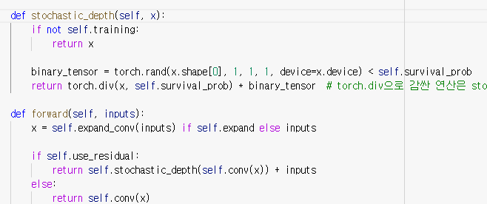
Source Code

Slide 31
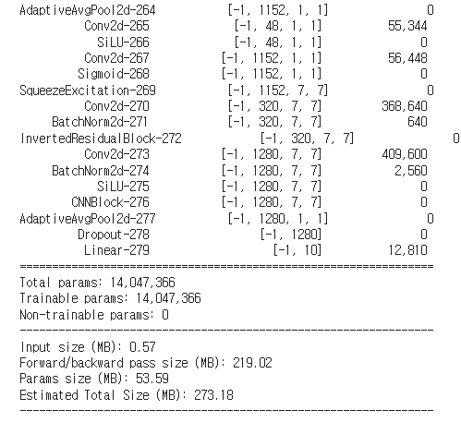
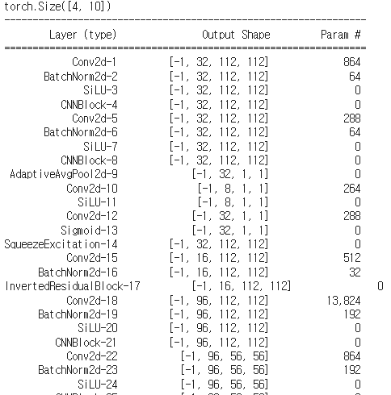
Source Code
.
.
.

Slide 32
Thank you

